Slide 1
Vho Mudivhi: G5
Make Umuzi better for the Umuzi Community by providing guidance in the Umuzi Program
Phathutshedzo Ramakhanya
Morongwe Moeketsi
Tinyiko Nyathi
Sibusiso Funani
Lehlohonolo Lefatle
Nhlakanipho Sola

Slide 2
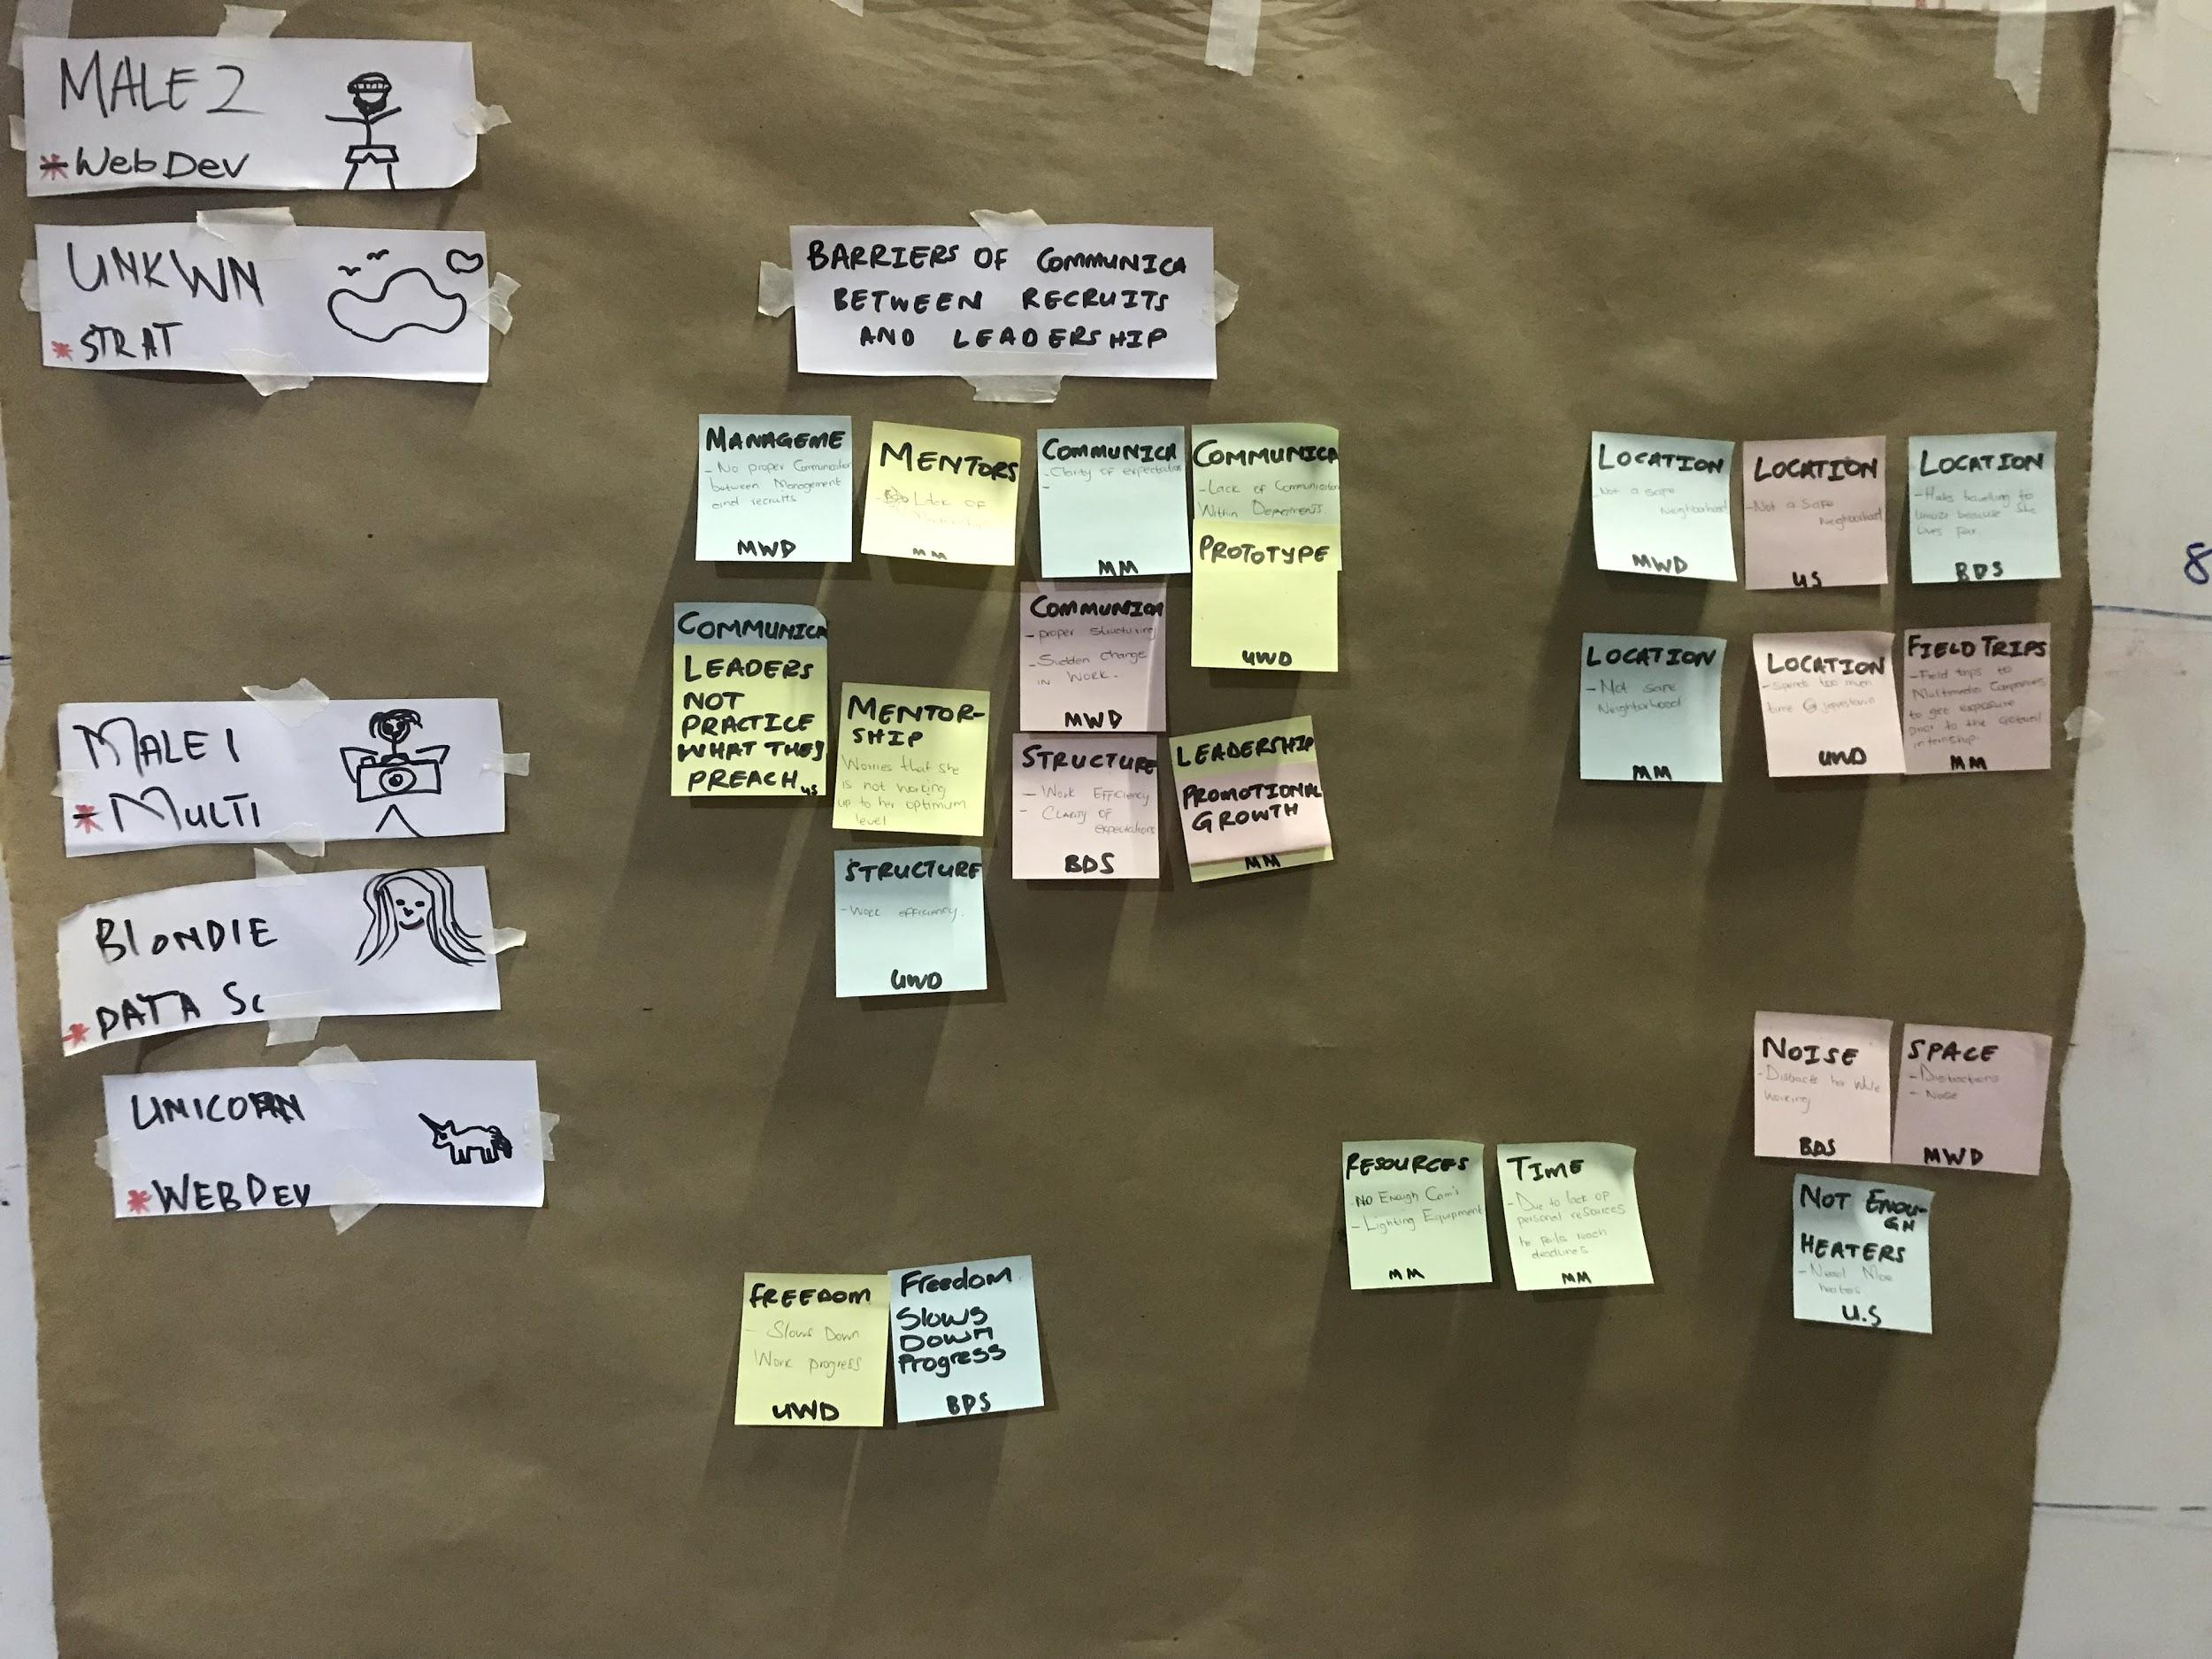
User Insights & Interviews
We interviewed five people and from their responses we bucketed their answers, and that’s where we were able to find that the lack of mentorship is a common problem under the communication bucket.

Slide 3
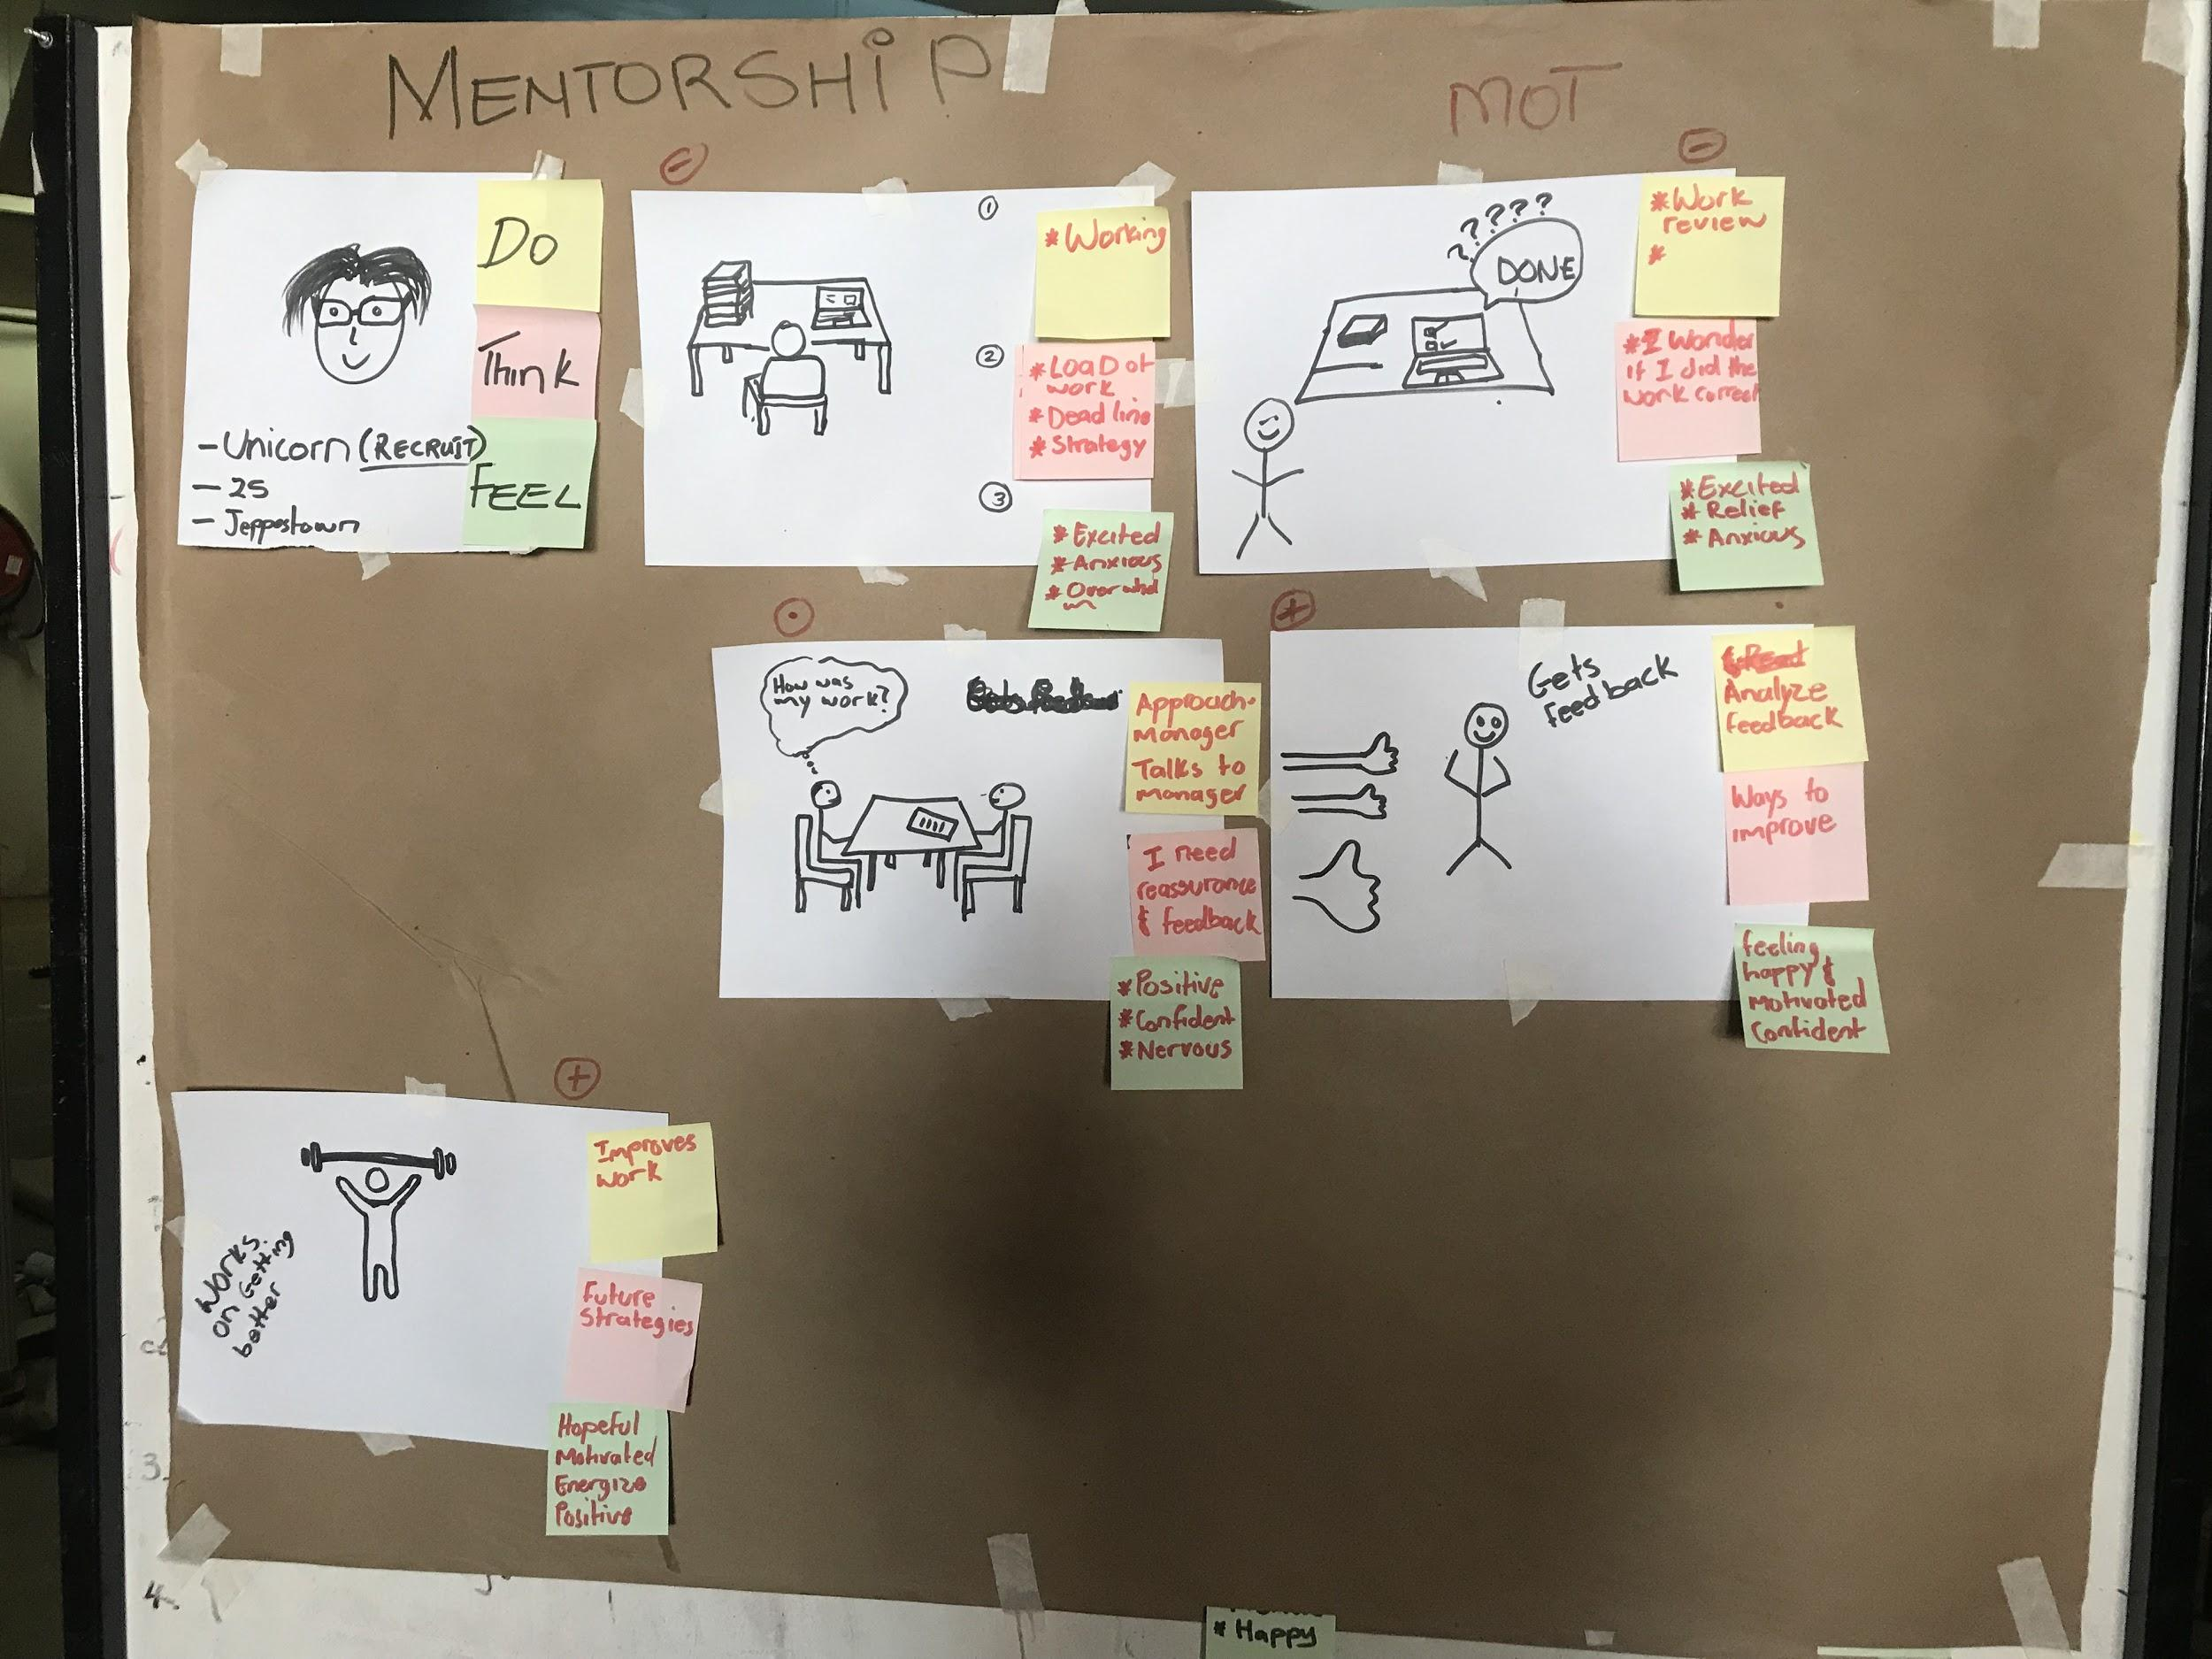
User Journey
Our chosen User Persona is Unicorn.
She is 24 years old. She’s in the Web Development department. The image on the left depicts Unicorn’s daily journey at Umuzi.
Unicorn is swamped with work, she has to start working on a brief. She needs to come up with a strategy to work around the brief and she feels anxious and overwhelmed.
Unicorn has done her best attempt to complete the brief, however, she is not sure if what she has done is what is required of her.
She decides to approach her manager before submission, for reassurance.
She gets her feedback.
She works on doing better the next time.

Slide 4
Interview insights from user journeys (Do think Feel)
After we have mapped out Unicorn’s journey within Umuzi, we then went back to the interviewees and asked them if this was their typical daily journey within Umuzi. We got a couple of insights based on our User Journey, and the general feelings that are usually experienced are anxiety, frustration, confusion, uncertainty and a bit of excitement.

Slide 5
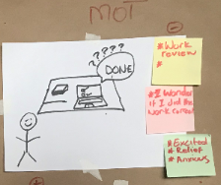
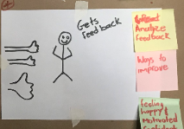
Moments of Fuel, Friction & Truth
This is the second frame of our User Journey and it is the Moment of Truth as well as the Moment of Friction. This is where Unicorn gets stuck. She is done with her work, however, she’s unsure of her work. She doesn’t know if she has done what’s expected of her. She needs to know what change to make ASAP before she reaches her deadline.
This is the last frame of our User Journey, and it represents the Moment of Fuel. This is where Unicorn receives the feedback, and she is happy, relieved and excited for the next project, in order to implement the new changes she has learned from the feedback.

Slide 6
Defining our poblem
Insight Statement
Umuzi community needs guidance through out the umuzi programme because currently there in no mentorship.
How Might We
Provide guidance through out the umuzi program for the umuzi community to facilitate mentorship.

Slide 7
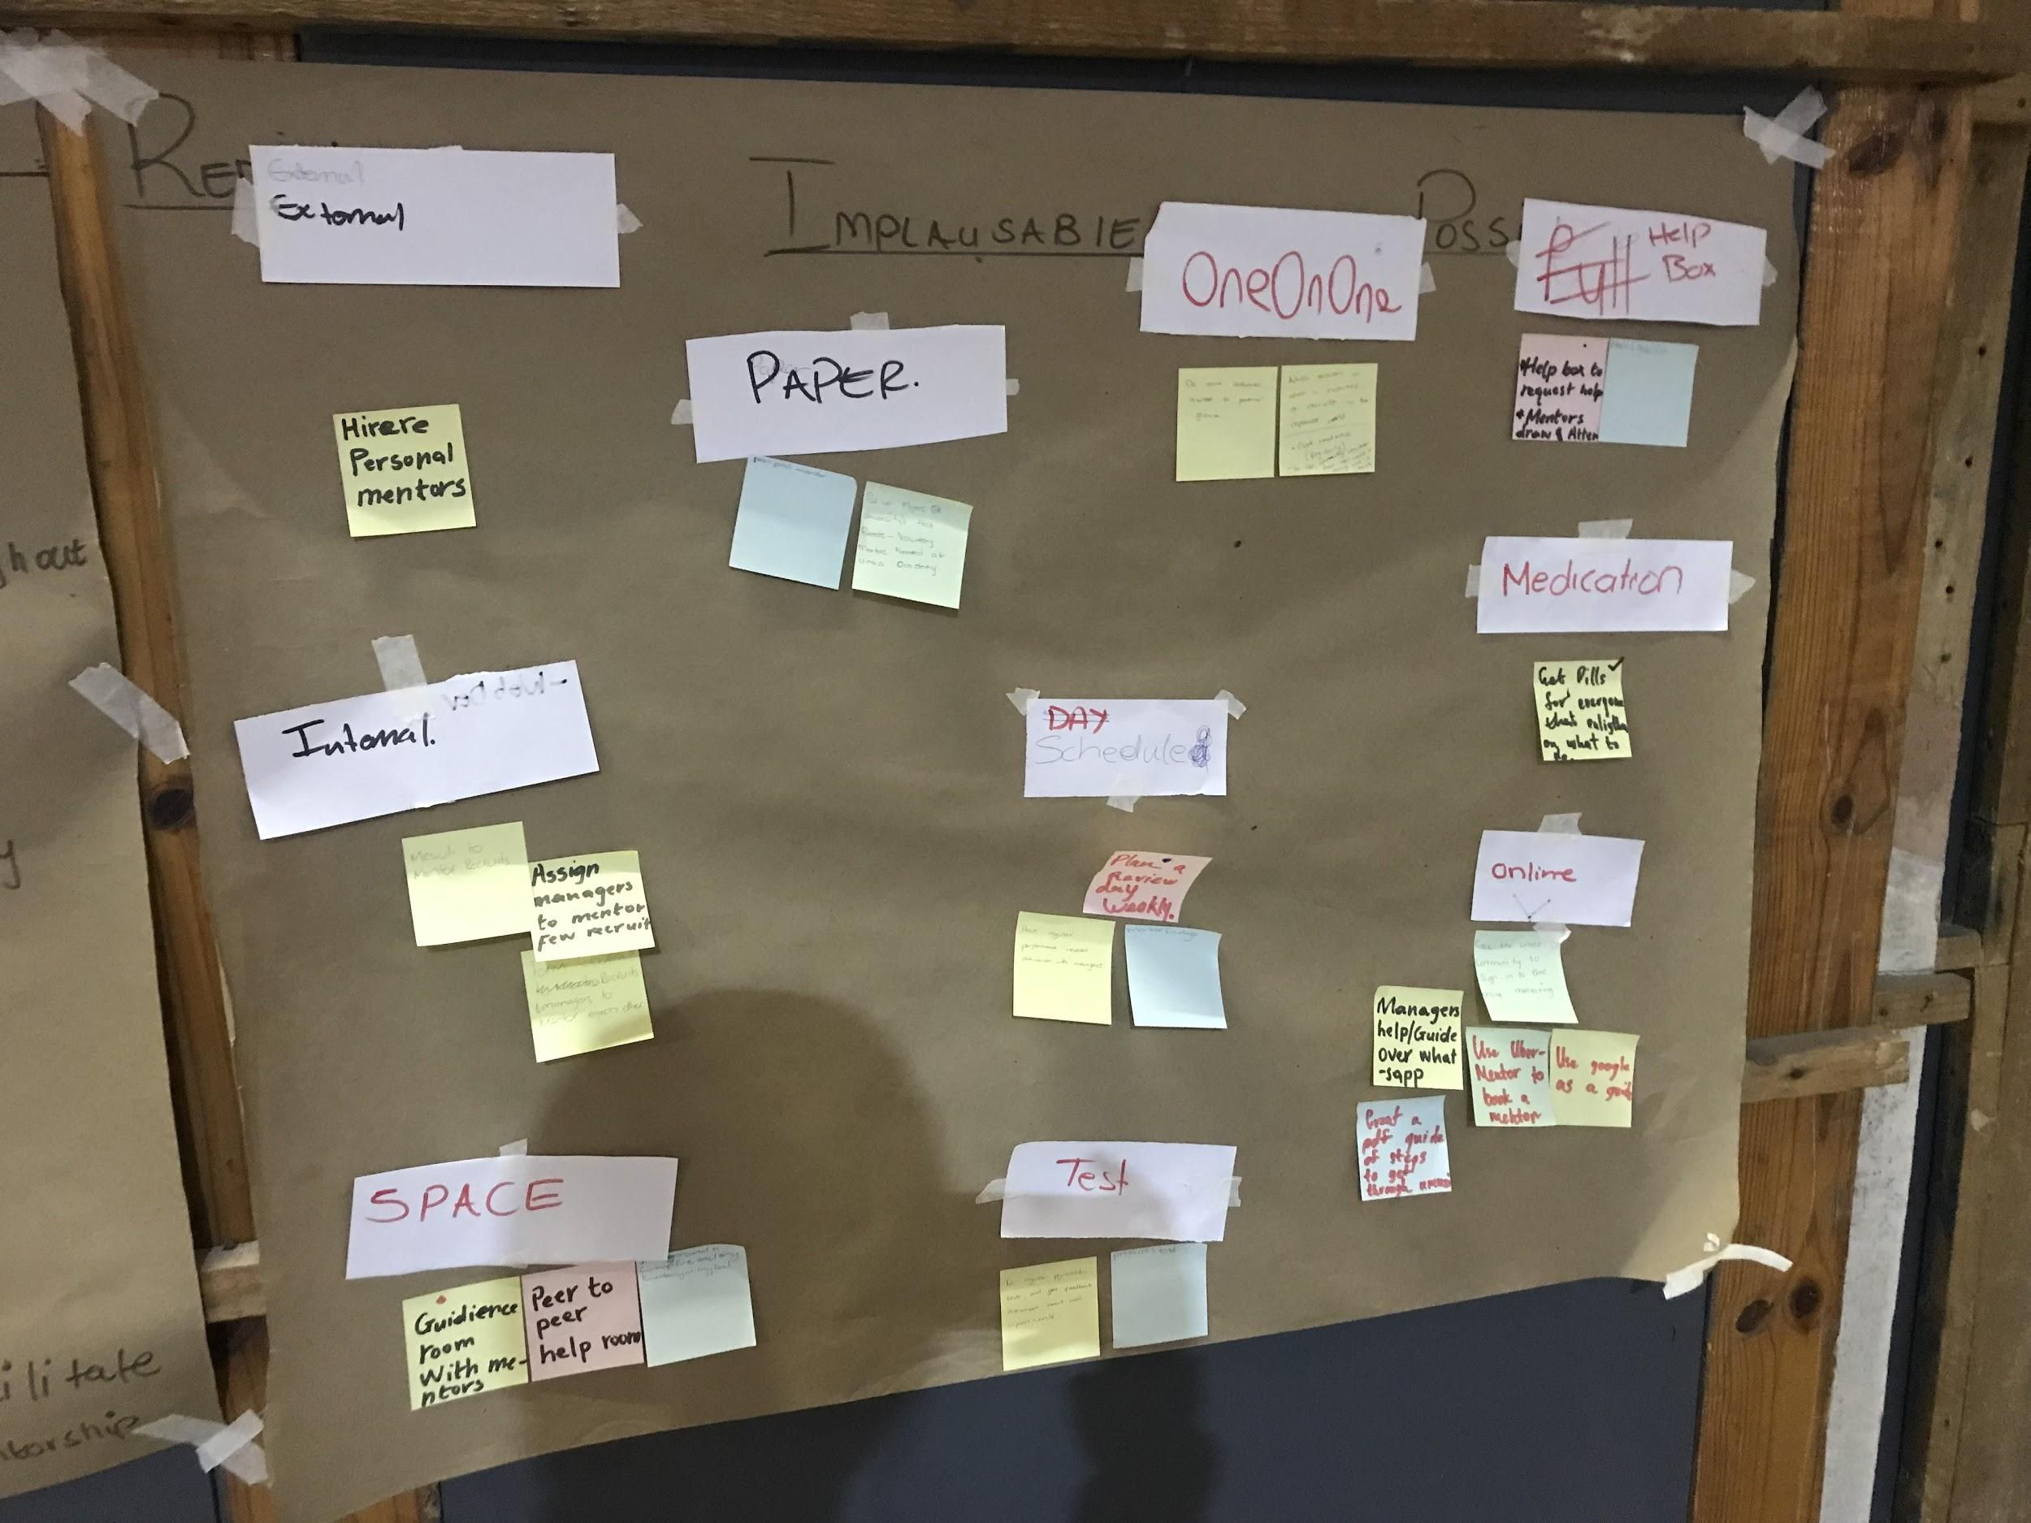
Brainstorm
We all sat down and wrote (in silence) our own separate ideas, using the RIP method. We put all our ideas together and came up with ten buckets, such as One-On-One, Online, Employing External Mentors, to name a few.
We voted and decided on five ideas that would lead up to our digital mentorship programme.
Please paste a photo of your brainstorm

Slide 8
Our chosen idea
We chose the mentorship idea.

Slide 9
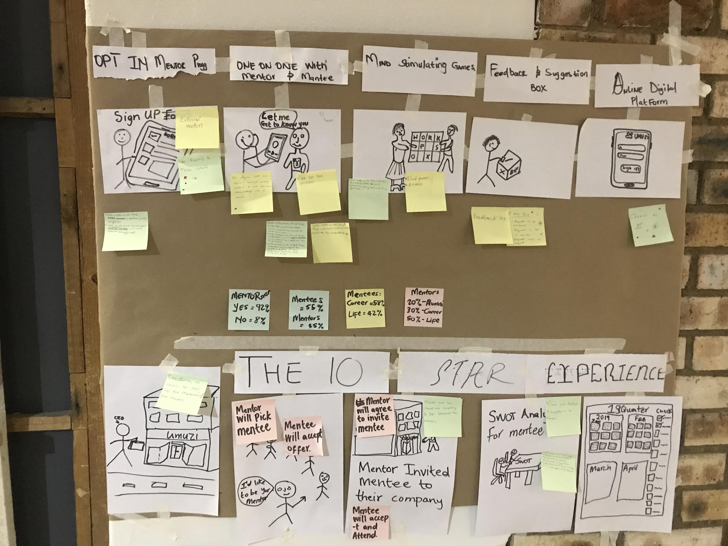
Storyboard & 10 Star
After voting we then took the most voted for ideas. With our five star experience the first frame depicts the mentor and mentee need to register to participate in the program. In the ten star experience, this would be where the mentors, preferably CEOs visit Umuzi in person.
The second frame the mentor and mentee then choose who they want to be partnered with. The ten star experience is where we have a social with CEOs and they pick who they would like to mentor from that social of getting to know each other. In the third frame the mentor and mentee meet and play mind stimulating games just to get to know each other. The ten star experience is where the CEO(mentore) invites the mentee to come and job shadow them at their place of work. In the fourth frame the mentor gives the mentee feedback on the session and the mentor give the mentee advice on what he/she has to work on and schedule their next meeting. The ten star experience for this is where the mentor and mentee come together for a SWOT analysis about the mentee. The last frame is about moving the mentorship program to a digital platform. The ten star experience is where they both create a schedule and checklist on future sessions together.

Slide 10
Key Assumptions & Tests
Assumption 1: Everyone would want to be in the Mentorship Program.Test: We asked 24 recruits, managers and alumni about their interests in the program. We got 22 interested individuals and 2 uninterested.
Assumption 2: We assumed that all managers would wanna be mentors.Test: A couple of managers actually did not wanna be mentors, but would much rather be mentored.
Assumption 3: We assumed that mentors would have time.Test: After we had done our prototype, we found that mentors were busy and they work on a planned schedule.
Statistics:
Sample Size = 24
Interested = 92% (22)
Uninterested = 8% (2)
Mentees = 55% (12)
Career Wise = 58% (7)
Life Mentorship = 42% (5)
Mentors = 45% (10)
Alumni Mentors = 20% (2)
Career Mentors = 30% (3)
Life Mentors = 50% (5)

Slide 11
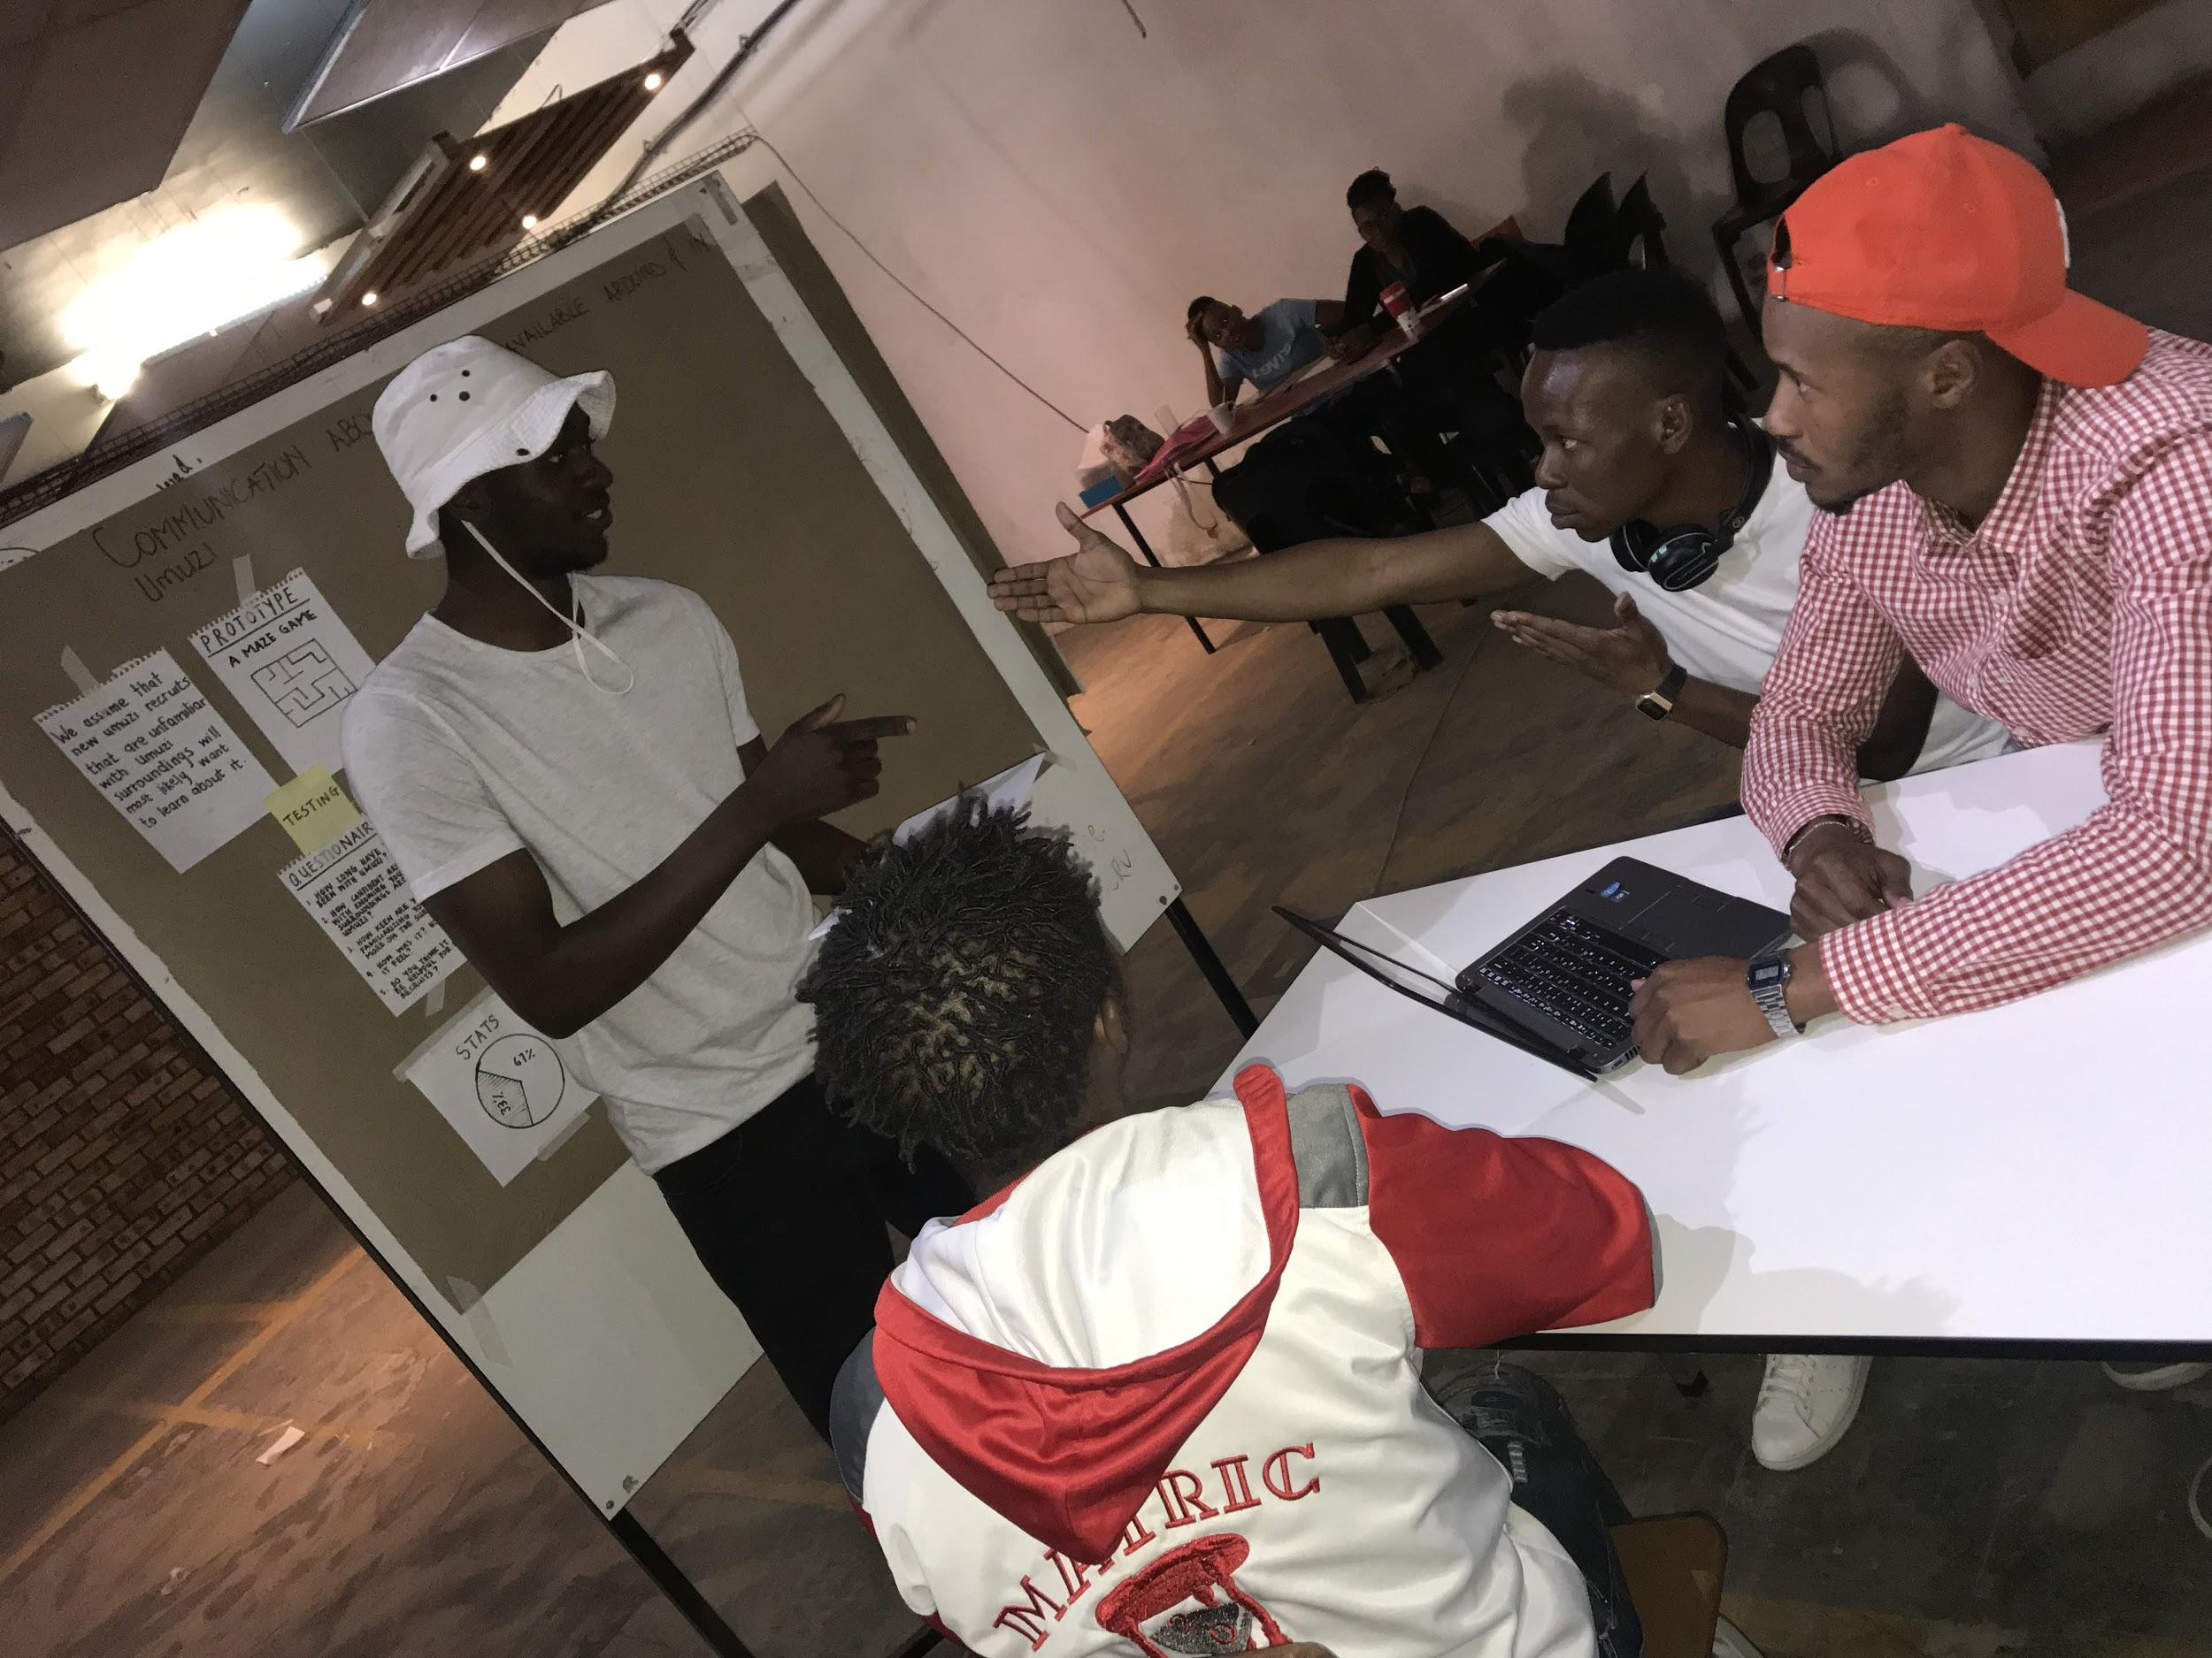
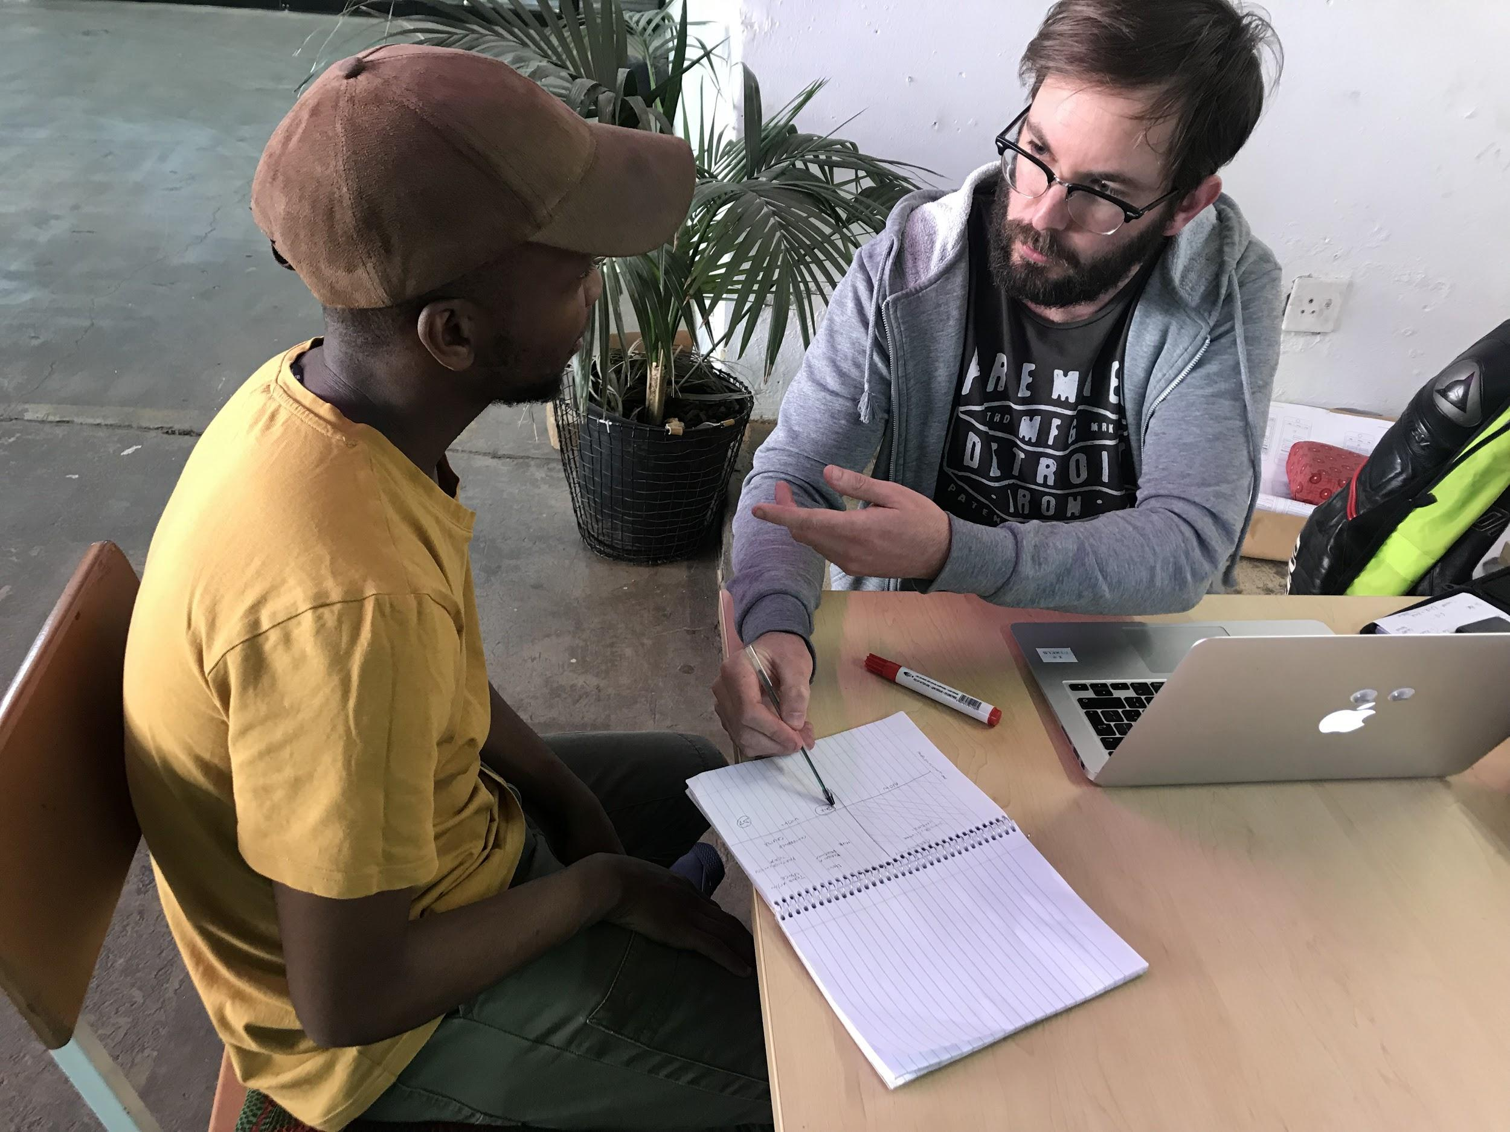
Our MVP
We also had a social, speed dating session where mentor and mentees would pair themselves up based on what they learned about each other, from each other.
We randomly paired mentors and mentees, and they had 10-15min one-on-one sessions and they each gave us feedback based on their sessions. This was the fastest and convenient way to test our assumptions, and it was effective.

